Slide 1


Content 5.0?
Reference Visuals
Joe Gollner
www.gollner.ca
jag@gnostyx.com

Slide 2
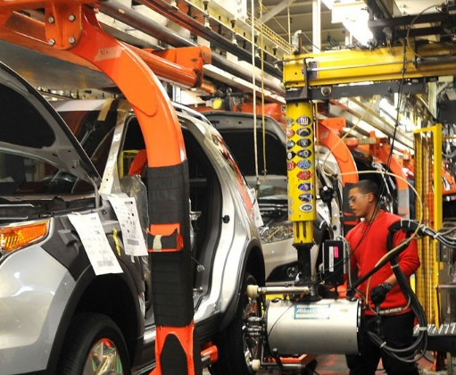
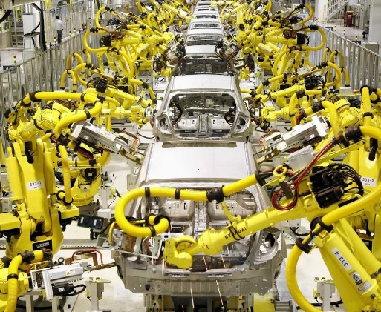
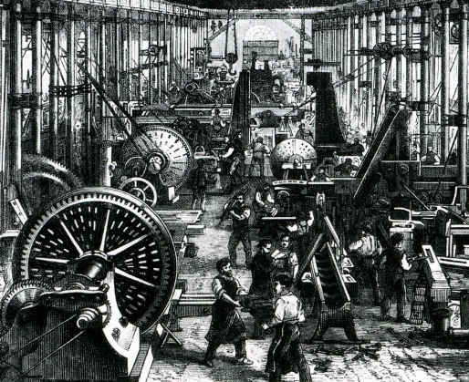
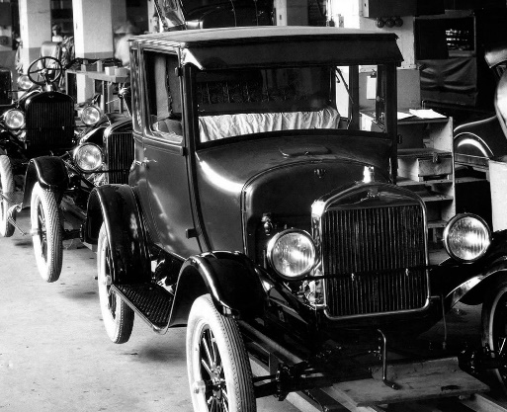
Point of Reference – Industry 4.0
The Fourth Industrial Revolution
  Industry 1.0: Mechanization | Division of Labor
  Introduction of Steam Power
  Industry 2.0: Standardization | Assembly Line
  Introduction of Electrical Power
  Industry 3.0: Integration| Computer-Aided Manufacturing
  Introduction of Automation
  Industry 4.0: Smart Manufacturing | Cyber-Physical Systems Introduction of Distributed Intelligence
  The proper relationship between people & machines
  has been a topic of inquiry & debate at each “level”
See the World Economic Forum (WEF)
https://www.weforum.org/focus/fourth-industrial-revolution/
3.0 Integrated
4.0 Smart
Efficiency | Portability | Processability | Adaptability
1.0 Mechanized
2.0 Standardized
Effectiveness | Range | Scale | Impact

Slide 3

Point of Reference – Industry 5.0
Industry 5.0 put forward as a Possible Extension
  Can be seen as championing an Emergent Capability
  where industrial Human-Cyber-Physical Systems are:
    Human-Centric
    Resilient
    Sustainable
  Not really an “Industrial Revolution” per se
  Advocates for a more collaborative & sensitive relationship between people & machines
See the European Commission on Industry 5.0
https://research-and-innovation.ec.europa.eu/research-area/industrial-research-and-innovation/industry-50_en
Robert Owen (1771-1858) Utopian Socialist
  “Hold my beer”
3.0 Integrated
4.0 Smart
5.0 Emergent
Efficiency | Portability | Processability | Adaptability
1.0 Mechanized
2.0 Standardized
Effectiveness | Range | Scale | Impact

Slide 4
Content 1.0 to 4.0…and if we have to 5.0
  Content 1.0: Content grounded in what
  an organization does & intends to do
  Content 2.0: Content optimized for use
  by people & machines across channels
  Content 3.0: Content integrated with all
  its sources & stakeholders
  Content 4.0: Content that evolves while moving between partners, customers and tools
  Content 5.0: New content that emerges through the collaboration of people and AI that leverages the content assets & ecosystem established under levels 1.0 to 4.0
3.0
Integrated
Content
4.0
Smart
Content
5.0
Emergent
Content
Efficiency | Portability | Processability | Adaptability
1.0
Authentic
Content
2.0
OmniChannel
Content
Effectiveness | Range | Scale | Impact

Slide 5
What Does It Matter?
Thinking about content from the perspective of these four levels challenges us to:
  Think carefully about what tools we use with our content assets
  Think carefully about how our investments in content interact with other investments
  Think carefully about content from multiple perspectives
  Think carefully about how AI
  is changing things
  Think carefully about how content technologies must evolve

